Slide 1
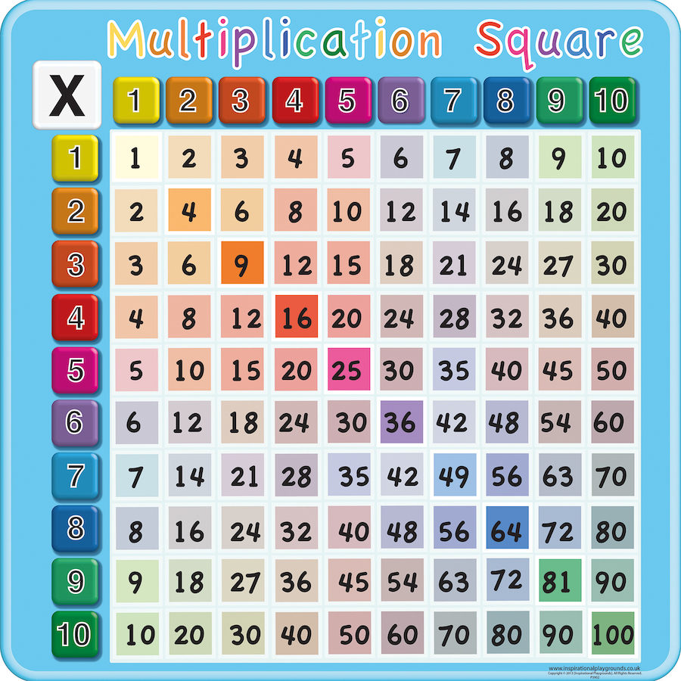
Parent Workshop Times Tables Key Stage 2

Slide 2
Over Learning, Mastery and Depth
Language: vocabulary/sentences ‘In our classes mathematical language is very important. Our students must know how to do, say and express maths.’ Teacher in Shanghai
Over learning through
an emphasis on
explanation and review
Contexts
Concrete resources
Range of manipulatives
Meaningful practice
Depth through
Making connections, describing structures, relationships and patterns
Solving problems
Reasoning
Generalising
Proof
Mastery: understanding, visualising and explaining structures and relationships
Shanghai: Understanding the Basics
‘Deep understanding of number. Fluency and flexibility, an understanding of structures and mastery of the vocabulary.’

Slide 3
Skip counting

Slide 5
1

Slide 7
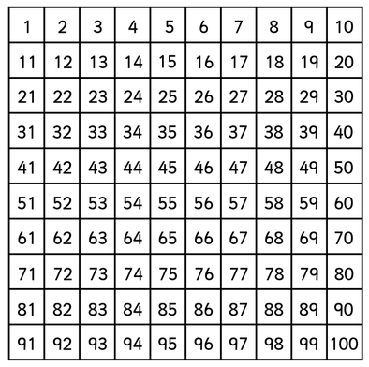

Slide 9
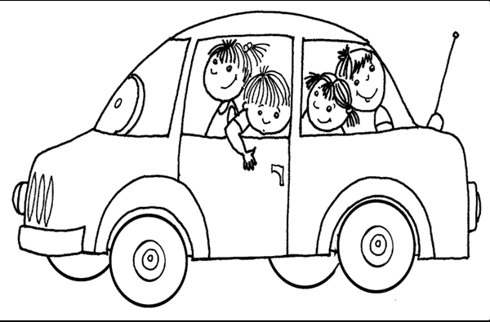
Models and Images for multiplication and division
Consider contexts for repeated addition:
2 - eyes
3 - triangles
4 - wheels on a car
5 – points of a star
6 – egg boxes, guitar strings, honeycomb
7 – days of the week,
8 – octopus
9 – planets
10 – ten pin bowling
Three cars, how many wheels?

Slide 10
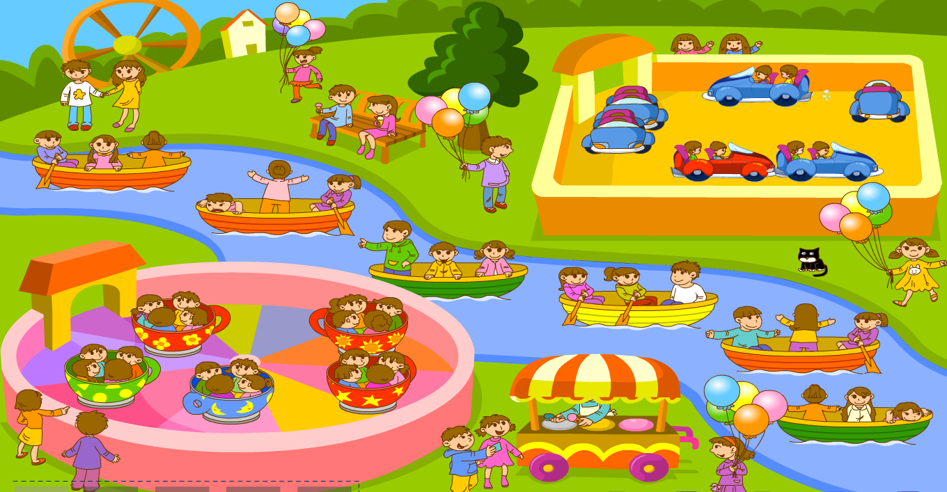

Slide 11
Only three people
in one boat
How many 3s？
One three

Slide 12
Only three people
in one boat!
How many 3s？
Two threes
How many children altogether?
3+3=6

Slide 13
What is happening in these
addition equations?
We are adding successively with the
same addend.
How many 3s？
Six threes
How many children altogether now？
3+3+3+3+3+3=18

Slide 14
The sentence of ten threes is very long, what shall I do if I want to write more 3s?
How many 3s？
ten threes
How many children altogether?
3+3+3+3+3+3+3+3+3+3=30

Slide 15
When we are doing successive addition
it will be easier if we use multiplication
How to describe ten threes
in multiplication?
How to describe ten threes
in multiplication?
How do I write ten threes
as a multiplication sentence?
The addition sentence:
3+3+3+3+3+3+3+3+3+3=30
Multiplication sentence
10 × 3 = 30
10 times 3 makes 30
10
The number of boats
3
The number of people in each boat
30
The number of people altogether

Slide 16
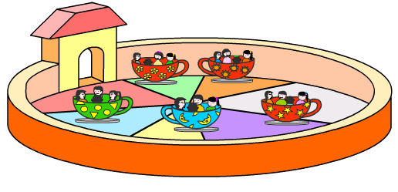
How many children
altogether in the cups？
4+4+4+4+4=20 (people)
Addition number sentence:__________________
5x4=20 (people)
Mulplication number sentence:_________________
How many cups?
5
How many people in each cup?
4
How many people altogether?
20

Slide 17
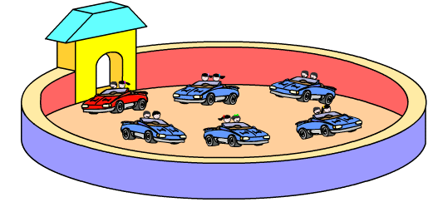
How many people
altogether in the cars？
2+2+2+2+2+2=12
addition number sentence:__________________
6x2=12(people)
mulplication number sentence:_________________
How many cups?
6
How many people in each cup?
2
How many people altogether?
12

Slide 18
Change the following addition sentences into multiplication sentences?
3+3+3+3+3=
5+5+5+5+5+5=
7+7+7+7+7+7+7+7+7=

Slide 19
Change these number sentences into multiplication sentences?
5+5+5+5+5+5
= 6 × 5
7+7
= 2 × 7
12-3-3-3-3
= 12 - 4x3
2+2+2+2+4
=2+2+2+2+2+2
= 6 × 2
= 3 × 4
=4+4+4
3+3+3+2+4
=3+3+3+3+3
= 5 × 3

Slide 20
Opportunities to make and draw arrays

Slide 21
Contexts for arrays
How do you know how many there are?

Slide 23
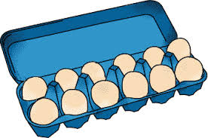
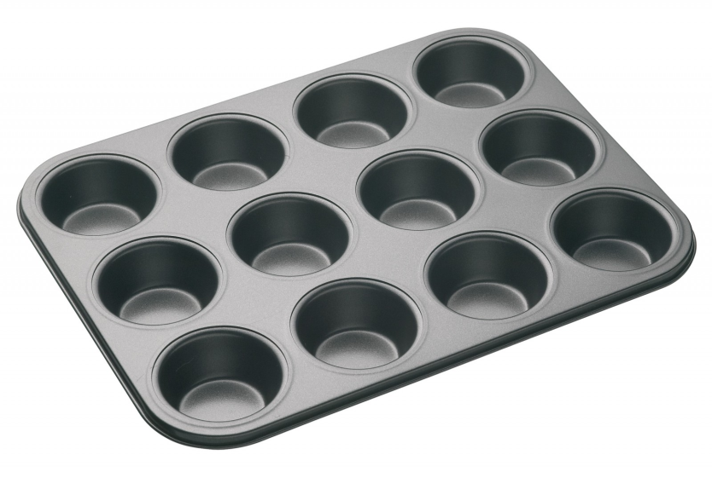
Other Contexts?

Slide 24
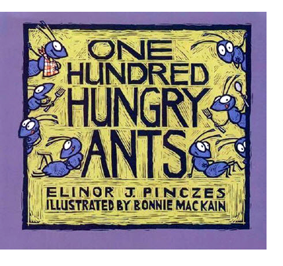
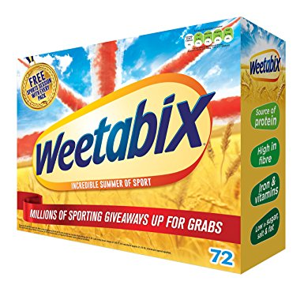

Slide 25
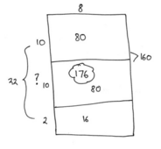
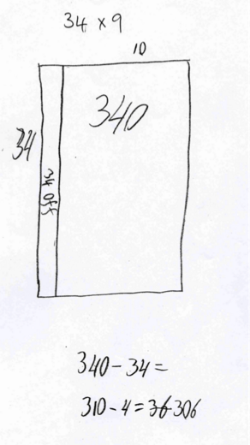
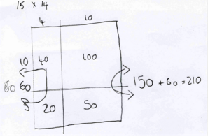

Slide 26
The Distributive Law
10
7
6
17 x 6 = (10 x 6) + (7 x 6)
Partition the multiplicand and then multiply the partitioned numbers by the multiplier

Slide 27
How would you partition/distribute this array?

Slide 28
20
4
10
6
24 x 16 =
20 x 10 = 200
20 x 6 = 120
10 x 4 = 40
6 x 4 = 24
200 + 120 + 40 + 24 = 384
24 x 16 = 384

Slide 29
The Distributive Law
43 x 37 =
40
3
30
7
30
7
1200
280
90
21
1591
40
1,200
280
What do you think is the most common mistake with the grid method?
Discuss with your partner.
3
90
21
43 x 37 = (40 x 30)
+ (40 x 7)
+ (3 x 30)
+ (3 x 7)
43 x 37 = 1,200 + 280 + 90 + 21
What does distribution mean? Discuss with you partner…

Slide 30
Would you rather?
6 x 7
9 x 5

Slide 31
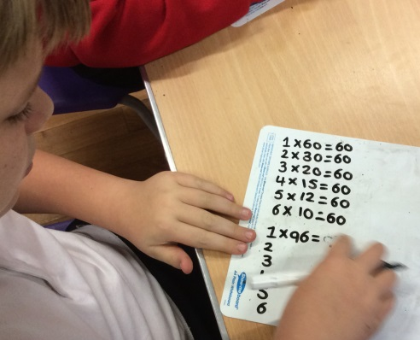
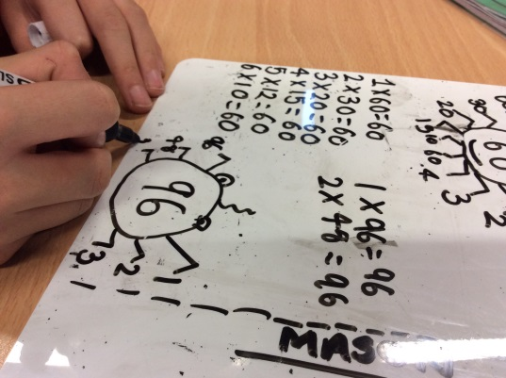
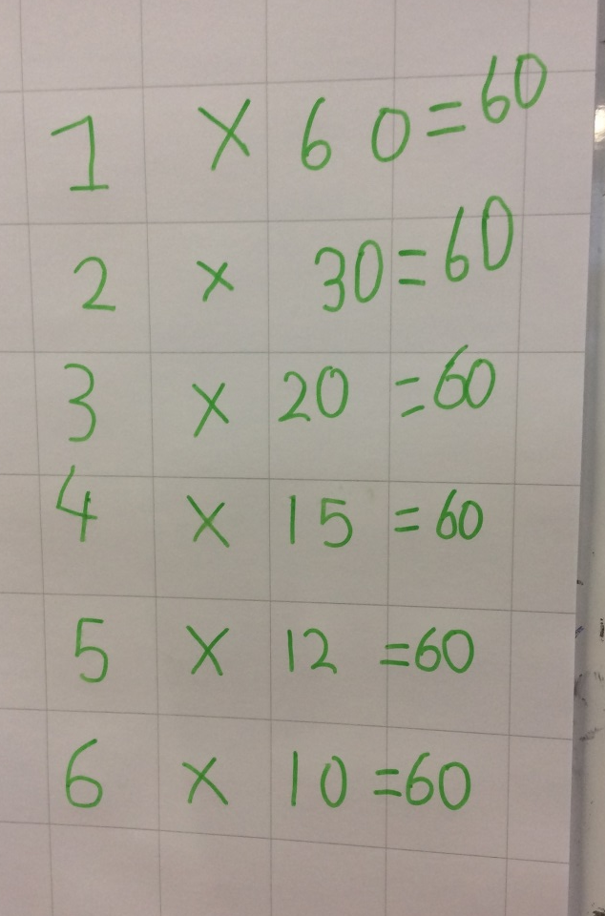
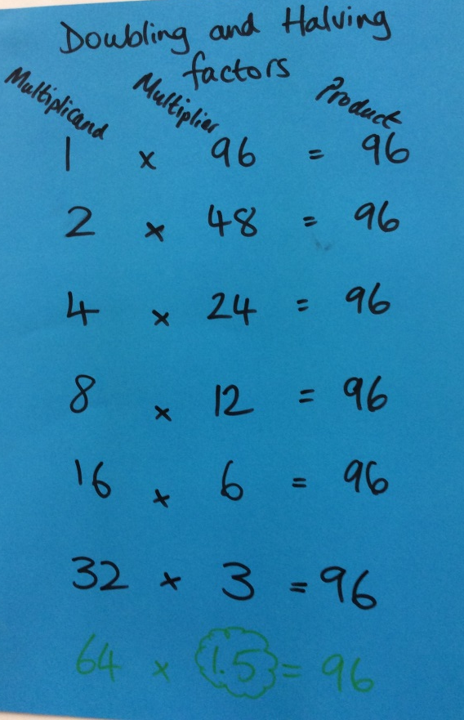
Factorising and finding prime numbers

Slide 32
How could the following calculations be solved mentally?
Why do your methods work?
Explain.
3.5 x 16
50 x 14

Slide 33
Make a array out of 12 cubes. How many different arrays can you make?
Now make an array out of 7 cubes. How many different arrays can you make?
WHY?

Slide 34
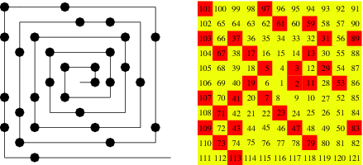

Slide 35
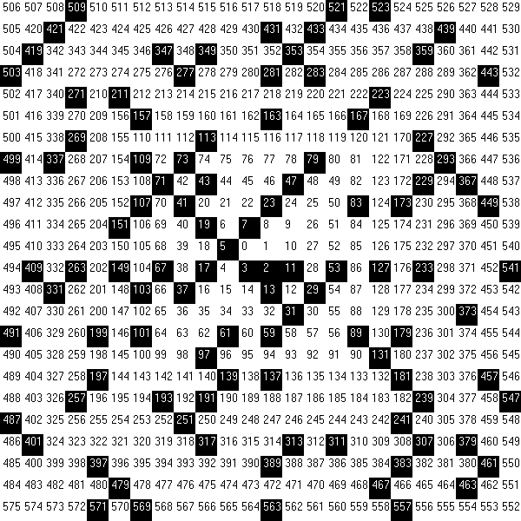

Slide 37
Do you recognise this sequence?
2
3
5
7
11
13
17
19
23
29
PRIME NUMBERS!!!!

Slide 38
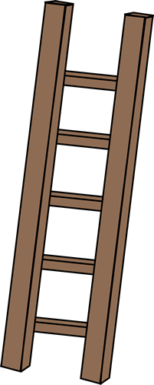
80÷10
32÷7
25÷5
76÷8
42÷4
48÷4
58÷6
49÷7
24÷6
28÷6
35÷6
29÷4
28÷9
34÷4
26÷4
40÷4
300÷10
48÷3
45÷7
70÷10
27÷9
34÷6
17÷3
60÷10
20÷6
30÷4
37÷5
21÷4
11÷4
51÷5
41÷6
24÷3
40÷8
50÷10
40÷10
43÷5
30÷10
32÷4
39÷3
32÷4
38÷4
32÷4
31÷3
16÷4
32÷4
18÷5
52÷2
23÷7
20÷10

Slide 39
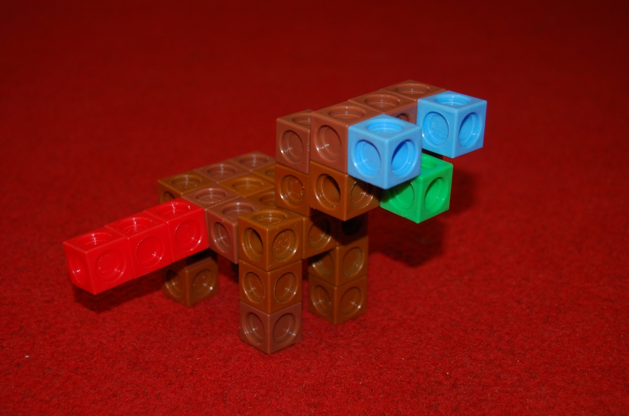
Multilink animals

Slide 40
Colour of multi link cube | Value | How many cubes have I used from this colour? | What is the total value of this colour?
 | 2
 | 3
 | 5
 | 8
 | 9
 | 10
 | 20
Target number:
467
VIB

Slide 41
Select 21 matchsticks…
How many squares can you build with the matchsticks?
How many sticks are left over?

Slide 42
21
We have _____ sticks in total. We use _____ sticks to make each square and the maximum number of squares we can make is _____, with _____ sticks remaining.
4
5
1
21 = x +
1
4
5

Slide 43
Using the same 21 matchsticks, make different shapes. Draw each combination on your whiteboard, including the remainders. Record what the equation would be.
21 =
3 x 7 + 0
21 = 4 x 5 + 1
21 =
5 x 4 + 1
21 =
6 x 3 + 3

Slide 44
Look at the equation below, what do we know and what do we not know? Consider what the missing numbers might be? Can you work in a systematic way?
= 3 x + 2

